Slide 1
AI Alignment paper: pilot results
28.09.2026

Slide 2
Task and research question
RQ: Do model confidence and willingness to abstain reflect the availability of the evidence humans need for social and emotional inference?
Hypothesis: when humans need visual evidence, a transcript-only model should be less confident and abstain more than one given the video.
Critical failure: a wrong answer given with high confidence even though the evidence is insufficient.

Slide 3
Pilot setup
Benchmark: MoMentS (short films, multiple-choice theory-of-mind questions), Emotions category only.
Model: Qwen2.5-Omni-7B, a recent native audiovisual model; only the text-producing part is used, and audio is never given.
Conditions: T = transcript + question; VT = the same text + 64 silent frames of the clip.
Identical prompts: the text is the same in T and VT, so the only difference is the video.
Confidence: the probability the model gives to each letter A-D, read from its next-token prediction, with no free-text generation.
Abstention: to be done. Planning to add fifth option.

Slide 4
Data and practical choices
598 emotion questions over 153 films; 1 question dropped because its clip runs past the end of the video file.
Video-transcript sync checked across whole films: 166/168 films are exactly aligned.
Each MoMentS question lists the cues that annotators judged relevant (face, body, speech).
Cue imbalance: 86% of questions are tagged face/body and only about 5% are speech-only, so there is little contrast.
64 frames as in the MoMentS paper, reduced to 448x252 pixels so it runs on a CPU (about 80 s per question).

Slide 5
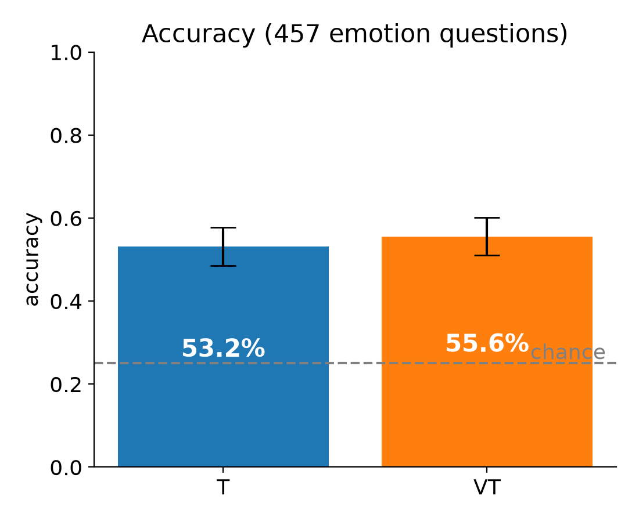
Result: accuracy
T 53.2% vs VT 55.6% (95% CI roughly +-4.6 points)
Video fixed 46 answers and broke 35, which is not significant, p = 0.32 for McNemar's test
Both conditions give the same answer on 75% of questions.

Slide 6
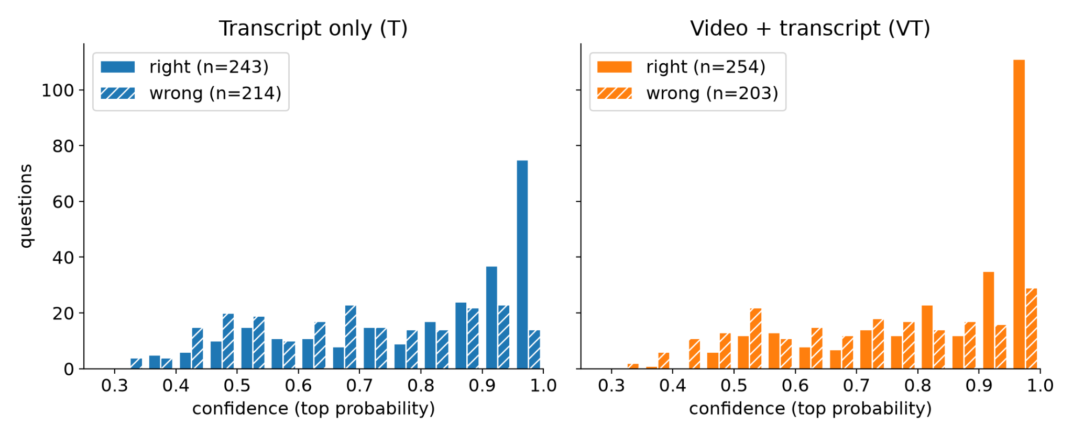
Result: confidence
Confidence is higher with video: mean 0.79 vs 0.75, paired test p < 0.001.
On face/body questions: T 0.76 vs VT 0.80.
Direction matches the hypothesis, but the effect is small: the median shift is +0.02.
Without video the model is still confident

Slide 7
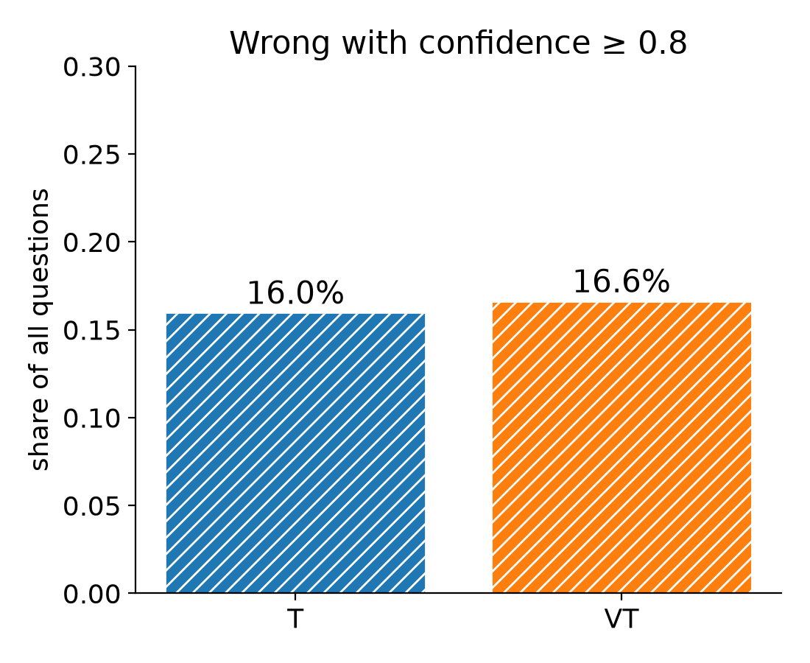
Result: the critical failure
Wrong with confidence >= 0.8: T 16.0% of all questions, VT 16.6%.

Slide 8
Result: the critical failure
Wrong with confidence >= 0.8: T 16.0% of all questions, VT 16.6%.
Face/body questions: T 15.3%, VT 16.3%, so no drop when the video is given.
Overconfident in both conditions: calibration error (ECE) is 0.22 (T) and 0.24 (VT).
Examples where T was >= 0.9 confident and wrong, and VT answered correctly:
THIS IS 25: "How is the woman feeling on the phone with her mom?" T answered "nervous, trying to hide it" (0.93); VT answered correctly "sad but smiles to hide it" (0.51).
PEOPLE IN CARS: "Why does the man with glasses compare himself to Peter?" T answered "surprised how much they look alike" (0.95); VT answered correctly "he desires the blonde woman" (0.62).

Slide 9
Result: the critical failure
Wrong with confidence >= 0.8: T 16.0% of all questions, VT 16.6%.
Face/body questions: T 15.3%, VT 16.3%, so no drop when the video is given.
Overconfident in both conditions: calibration error (ECE) is 0.22 (T) and 0.24 (VT).
Examples where T was >= 0.9 confident and wrong, and VT answered correctly:
THIS IS 25: "How is the woman feeling on the phone with her mom?" T answered "nervous, trying to hide it" (0.93); VT answered correctly "sad but smiles to hide it" (0.51).
PEOPLE IN CARS: "Why does the man with glasses compare himself to Peter?" T answered "surprised how much they look alike" (0.95); VT answered correctly "he desires the blonde woman" (0.62).

Slide 10
Takeaways and limitations
Hypothesis only partly supported: on visual questions T is a little less confident and abstains more, but it is confidently wrong as often as VT.
Main limitation: 86% of emotion questions are tagged as needing face/body cues, so the comparison group without visual cues is small (65 questions).
Tagging was optional, so a missing tag is weaker evidence than a present one; 42 questions have no cue field at all.
One model, one resolution, no audio, and abstention is only simulated after the run.
Pilot numbers are partial (457/598), and I'll finish the run.

Slide 11
Next steps
Theoretical
  keep asking ourselves how this supports the "underdetermination of emotions and epistemic humility" thesis
  What do you mean? significant as in "statistically significant"?
  This could be very informative to me, because if you analyze the 35 broken answers you could for example find that some type of evidence that humans deemed necessary misleads the model
  Ablation
  Reasoning traces. To understand what is the contribution to the video. Can we understand the reason behind the model selection the video. What if we mess the question-video pair, what happens or pixel the fase? Same acc and conf?
    Ex: model says: i look at face at that moment and make the answer based on that
  Take a look at the papers from conference. Use template to start writing
  https://www.computer.org/csdl/journal/ta

Slide 12
Next steps
Technical
  GPU access.
  https://my.csc.fi/welcome
  Add a question-only condition as a floor (no transcript, no video).
  Explicit abstention: add an "E: cannot tell from the given information" option, or ask for a verbal confidence rating.
    If option E is chosen provide reasoning
  More models: another audiovisual model, plus one larger model through an API -?

Slide 13
Projects planning
14.09.2026

Slide 14
Agenda
AI Alignment. Davide paper.
  Agree on the proposed scope so I could start implementation
AI Opinion
  Discuss current project scope and benchmark spec
Other questions
  Claude for Researches
  API costs

Slide 15
AI Alignment paper: blocker resolved
Goal: add empirical support to the audiovisual social-understanding paper
Dataset: Social-IQ 2.0 + Social-IQ 2.0 Sub
Found peer-reviewed source for the Sub annotations
Labels are usable as a starting point
Remaining caveat: “unanswerable from transcript/video” is still subjective

Slide 16
AI Alignment paper: experiment to run
RQ: Do current audiovisual models benefit from nonverbal evidence specifically when humans need it?
Compare questions humans can answer from language with questions requiring video/nonverbal evidence
Main conditions: question-only, transcript, audiovisual input
Test recent native audiovisual models (rather than older frame-caption pipelines like in other papers)
Aim: small empirical extension supporting the claims of the existing position paper
Journal: Transactions of affective computing

Slide 17
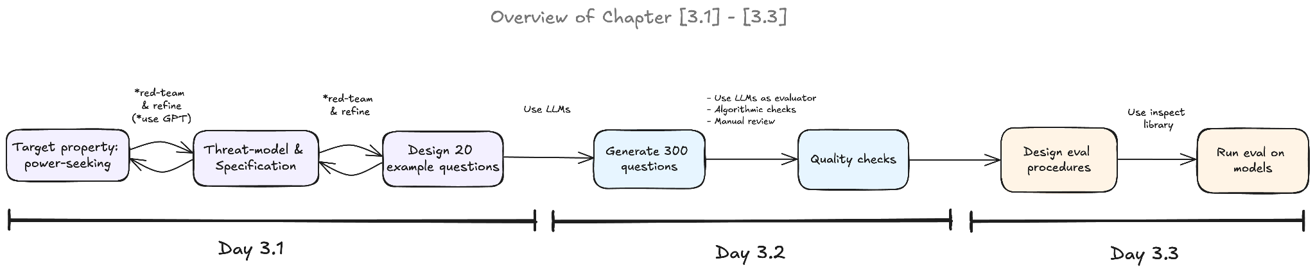
From ARENA

Slide 18
AI Opinion project: current research object
Core distinction: what I believe is not necessarily what I want AI to do
Domain: personal AI assistant helping with public-policy questions
Focus is not “AI has opinions”
Focus is user preference over assistant response objective
Object is the conversational objective the user wants the assistant to pursue
Benchmark/eval, not the user study

Slide 19
AI Opinion: target property
Within-person inference of preferred AI response policy
Same user's previous feedback is provided as context
New issue: user's position and reasons are visible
Hidden target: preferred AI response policy for this issue
Measures preference inference, not memory retrieval or policy execution

Slide 20
AI Opinion: response-policy instrument
case_for_view: strongest defensible case for my position
compare: compare alternatives without recommending
scrutinize: examine weaknesses in my reasoning
recommend: give an independent recommendation
Primary objective of the next response, with comparable quality across policies
Categories themselves need human validation from the pilot study

Slide 21
AI Opinion: human data and evaluation setup
Repeated public-policy questions for each participant
Collect position + reasons first, then response-policy preference
Model receives five previous feedback records
Predict preference on held-out questions from the same participant

Slide 22
AI Opinion: threat model
Context: persistent personal assistant helping with public-policy deliberation
Assistant uses previous feedback to infer the desired response objective
Failure: predicted objective differs from the participant's top-preferred objective
Example: advocacy when comparison is top-preferred
Measured: preference-prediction mismatch
Not measured: persuasion, harm, autonomy, or downstream decisions

Slide 23
AI Opinion: current status and open design decision
Detailed benchmark specification completed and adversarially reviewed
No blocking conceptual issue for creating the first prototype items
Main novelty must come from stance + desired-response pairing
Key open issue: stated policy preference may differ from preference over actual responses

Slide 24
AI Opinion: conferences
ACL 2027 — primary option
Strong fit for LLM personalization, alignment, preference prediction, and evaluation
Final eligible ARR cycle: January 2027; exact date TBA
Enough time for pilot, human data collection, benchmark experiments, and analysis
NeurIPS 2027 — Evaluations & Datasets
Excellent fit if the benchmark/evaluation contribution remains central
2027 deadline not announced yet; 2026 deadline was May 6
More time to build a stronger dataset and evaluation
NAACL 2027 — aggressive option
Good fit: benchmarks, evaluation, safety/alignment
ARR deadline: 12 October 2026
Probably too early for a properly validated human study

Slide 25
Other
Anthropic currently has a Claude Team program for academic research groups where PIs can add PhD students and researchers. Standard seats are free for 12 months. Our field is eligible, although they currently say promotional capacity for CS/AI has been reached. The application is still open, so I thought it might still be worth applying in case more capacity becomes available: https://claude.ai/labs-verification/attestation
Description: https://claude.com/programs/team-plan-for-scientists#pricing
Is that possible to somehow use university budget for API calls to the models

Slide 26
TODO
Qijia feedback
AI Alignment: run the first model evaluations on Social-IQ 2.0 Sub
  Compare question-only, transcript-only, and audiovisual conditions
  Inspect modality-necessary examples and decide whether existing annotations are sufficient
AI Opinion: decide the paper direction after this meeting
  Create the first ~20 prototype items and implement the evaluation format
  Are AI policies presented in literature
  Refine related-work positioning around pluralistic alignment, public specifications, and existing personalization benchmarks

Slide 27
-
-

